Slide 1


Machine Translation: A Game Changer for the Translation Professionals?
TII - Sixth Annual International Translation Conference
Doha, Qatar
March 23 2015
Stephan Vogel, QCRI
Francisco Guzmán, QCR
*with great help of QCRI’s MT team

Slide 2


In a world of increasing information …
Information online is growing exponentially!
More content: News, blogs, status updates, tweets, etc.
Notes:
We live in an era where
More content is created every second:
From news, status updates, tweets.

Slide 3


… and many languages …
4000-5000 different languages in the world
Access to information is limited by language barrier.
Notes:
But the access to this information is limited
By the languages we can read/speak

Slide 4


… we need Machine Translation
As a quick and accessible mean to perform translation.
Notes:
And that represents a problem of equal information access
That’s why we need Machine Translation
As a quick and cheap way to perform translation

Slide 5
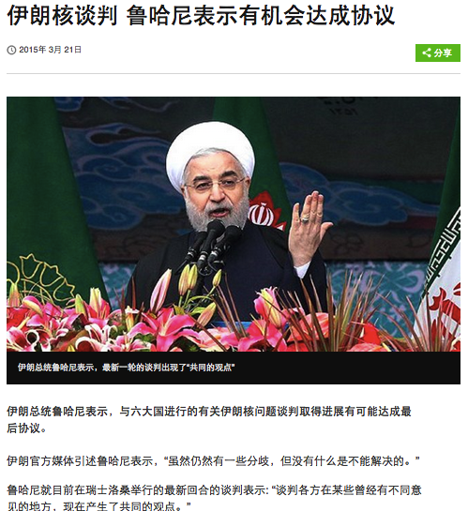
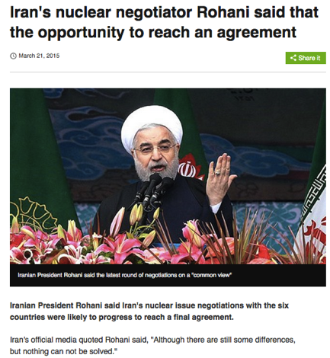
Pop quiz: what is he saying?
Rohani: Iran’s President
Options
Happy Nowruz !!! (Persian New Year)
Peace with Israel will be signed soon
Iran is facing hardship with deceasing oil prices
A nuclear agreement can be achieved
Notes:
So, question,
Who in the audience can read Arabic?
What do you think she’s saying?
Raise your hand if you think that A)
B)
….
Well the answer is D.
And we know that because we’ve used MT to translate this news article

Slide 6
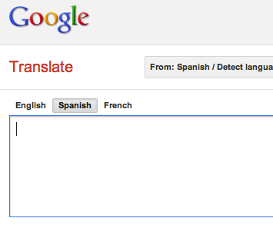
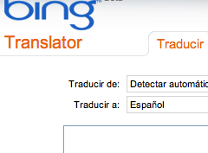
Online translators are good examples
Notes:
Many of you are familiar with the translation engines available online.
They are a good example of Machine Translation systems

Slide 7
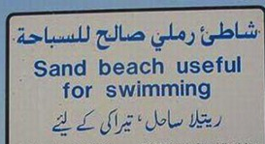


yet better automatic translators are necessary
Google Music competirá con la tienda dominante, iTunes de Apple, y otros servicios digitales de música.
La tienda de Google venderá canciones por un precio estimado a un dólar la canción, informó el Wall Street Journal.
Google Music Store to compete with dominant, Apple iTunes and other digital music services.
Google's store sold songs for an estimated price for a dollar a song, the Wall Street Journal.
Notes:
All that said, Machine Translation has come a long way since its beginnings,
Now a days, pretty accurate translations can be obtained for certain language pairs.
But, things aren’t perfect and there is still a long way to go.

Slide 8
In this talk
How does Machine Translation work?
MT in a nutshell
The possibilities and limitations
Why does it matter to you?
MT is not going to take your job ;)
New workflows enabled by technology
What comes next?
Our work @QCRI
Opportunities for collaboration

Slide 9
MT in a nutshell
Part I: Back to basics…

Slide 10
Let’s start with an example
and use pen & paper

Slide 11
Deciphering Example
Parallel Corpus (some characters adapted)
Can we build a lexicon from these sentence pairs?
Observations:
Apinaye: Kukre (1) Ape (5), English: The (6), works (5) Aha! -> first guess: Ape – works
monkey in 1, 3; child in 2, 4; man in 4, 6 different distribution over corpus: do we find words with similar distribution on the Apinaye side?
Kukre kokoi | The monkey eats
Ape kra | The child works
Ape kokoi rats | The big monkey works
Ape mi mets | The good man works
Ape mets kra | The child works well
Ape punui mi pinjets | The old man works badly

Slide 12
… Vocabularies
Corpus Vocabularies
Kukre kokoi | The monkey eats
Ape kra | The child works
Ape kokoi rats | The big monkey works
Ape mi mets | The good man works
Ape mets kra | The child works well
Ape punui mi pinjets | The old man works badly
Apinaye | English
kukre | The
kokoi | monkey
ape | eats
kra | child
rats | works
mi | big
mets | good
punui | man
pinjets | well
 | old
 | badly
Observations:
9 Apinaye words, 11 English words
Expectations:
English words without translation?
Apinaye words corresponding to more then 1 English word?

Slide 13
… Word Frequencies
Corpus Vocabularies, with frequencies
Kukre kokoi | The monkey eats
Ape kra | The child works
Ape kokoi rats | The big monkey works
Ape mi mets | The good man works
Ape mets kra | The child works well
Ape punui mi pinjets | The old man works badly
Apinaye |  | English
kukre | 1 | The | 6
kokoi | 2 | monkey | 2
ape | 5 | eats | 1
kra | 2 | child | 2
rats | 1 | works | 5
mi | 1 | big | 1
mets | 2 | good | 1
punui | 1 | man | 2
pinjets | 1 | well | 1
 |  | old | 1
 |  | badly | 1
Suggestions:
‘ape’ (5) could align to ‘The’ (6) or ‘works’ (5)
More likely that content word ‘works’ has match, i.e. ‘ape’ = ‘works’
Other word pairs difficult to predict – too many similar frequencies

Slide 14
… Location in Corpus
Corpus Vocabularies, with sentence number
Kukre kokoi | The monkey eats
Ape kra | The child works
Ape kokoi rats | The big monkey works
Ape mi mets | The good man works
Ape mets kra | The child works well
Ape punui mi pinjets | The old man works badly
Apinaye | Sentences | English | Sentences
kukre | 1 | The | 1 2 3 4 5 6
kokoi | 1 3 | monkey | 1 3
ape | 2 3 4 5 6 | eats | 1
kra | 2 5 | child | 2 5
rats | 3 | works | 2 3 4 5 6
mi | 4 6 | big | 3
mets | 4 5 | good | 4
punui | 6 | man | 4 6
pinjets | 6 | well | 5
 |  | old | 6
 |  | badly | 6
Observations:
Same sentences: ‘kukre’ – ‘eats’, ‘kokoi’ – ‘monkey’, ‘ape’ – ‘works’, ‘kra’ – ‘child’, ‘rats’ – ‘big’, ‘mi’ – ‘man’
‘mets’ (4 and 5) =? ‘good’ (4) and ‘well’ (5); makes sense
‘punui’ and ‘pinjets’ match ‘old’ and ‘badly’ – which is which?

Slide 15
… Location in Sentence
Corpus
Apinaye | English | Alignment EN - AP
Kukre kokoi | The monkey eats | 1-0 2-2 3-1
Ape kra | The child works | 1-0 2-2 3-1
Ape kokoi rats | The big monkey works | 1-0 2-3 3-2 4-1
Ape mi mets | The good man works | 1-0 2-3 3-2 4-1
Ape mets kra | The child works well | 1-0 2-3 3-1 4-2
Ape punui mi pinjets | The old man works badly | 1-0 2-??? 3-3 4-1 5-???
Observations:
First English word (‘The’) does not align; we say it aligns to the NULL word
Apinaye has verb in first position
English last word aligns to 1st or 2nd position
English -> Apinaye: reverse word order (not strictly in sentence pair 5)
Hypothesis: alignment for last sentence pair is 1-0 2-4 3-3 4-1 5-2
I.e: ‘pinjets’ – ‘old’ and ‘punui’ – ‘badly’

Slide 16
… POS Information
Corpus
Kukre kokoi | V N | The monkey eats | DET N V
Ape kra | V N | The child works | Det N V
Ape kokoi rats | V N Adj | The big monkey works | Det Adj N V
Ape mi mets | V N Adj | The good man works | Det Adj N V
Ape mets kra | V Adv N | The child works well | Det N V Adv
Ape punui mi pinjets | V ??? N ??? | The old man works badly | Det Adj N V Adv
Observations:
English determiner (‘The’) does not align; perhaps no determiners in Apinaye
English Verb Adverb -> Apinaye: Verb Adverb -> no reordering
English Adjective Noun -> Apinaye: Noun Adjective -> reordering
Hypothesis:
‘pinjets’ is Adj to make it N Adj, ‘punui’ is Adv (consistent with alignment hypothesis)

Slide 17
Translate New Sentences: Ap - En
Source Sentence: Ape rats mi mets
Lexical information: works big man good/well
Reordering information: The good man works big
Better lexical choice: The good man works hard
Compare: Ape mi mets -> The good man works
Source Sentence: Kukre rats kokoi punui
Lexical information: eats big monkey badly
Reordering information: The bad monkey eats big
Better lexical choice: The bad monkey eats a lot

Slide 18
Translate New Sentences: En - Ap
Source Sentence: The old monkey eats a lot
Lexical information: NULL pinjets kokio kukre rats
Reordering information: kukre rats kokio pinjets
Or
Deleting words: old monkey eats a lot
Rephrase: old monkey eats big
Reorder: eats big monkey old
Lexical information: kukre rats kokio pinjets
Source Sentence: The big child works a long time
Delete plus rephrase: big child works big
Reorder: works big child big
Lexical information: Ape rats kra rats

Slide 19
You've just done tiny-scale MT
By hand

Slide 20
Data – Large Data
Qatar Foundation for Education, Science and Community Development (QF) aims to support Qatar on its journey from a carbon economy to a knowledge economy by unlocking human potential.
It was established in 1995 by His Highness the Amir Sheikh Hamad bin Khalifa Al-Thani. His wife, Her Highness Sheikha Moza bint Nasser, is the organization’s chairperson and driving force.
Qatar National Vision 2030 was published in July 2008 and outlines how the nation will use its vast revenues from hydrocarbon resources to transform itself into a modern knowledge-based economy.
The people of Qatar are the key to achieving this aim, so the plan places developing human resources as the main priority for the next 20 years.
National Vision 2030 gave QF an exciting mandate: to be the ‘engine’ driving the development of Qatar’s people, with the headline aim of ‘Unlocking Human Potential’.
QF aims to unlock the human through its three pillars of Education, Science & Research and Community Development. This will benefit not only Qatar, but the region & the world.
It is bringing world-class education, work experience and career opportunities to Qatar’s young people;
It is building Qatar's innovation and technology capacity by developing and commercializing solutions through key sciences.
It is fostering a progressive society, enhancing cultural life and protecting Qatar’s heritage whilst addressing immediate social needs in the community.
All these things will help create a forward-looking knowledge economy for Qatar.

Slide 21
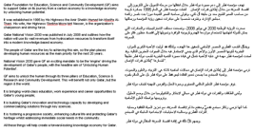
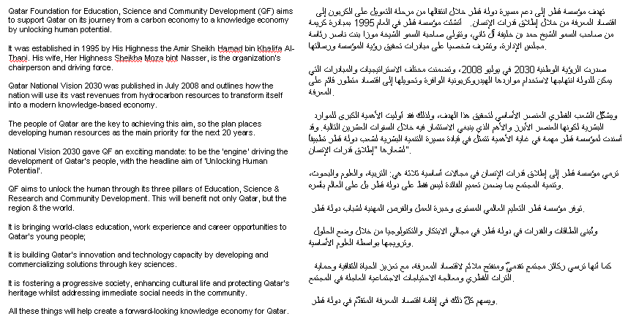
100

Slide 22
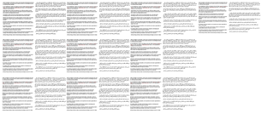
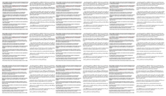
1,000 sentences

Slide 23


10,000 sentences = 1 book
Notes:
Small book

Slide 24


100,000 sentences = stack of book
Notes:
A few books

Slide 25
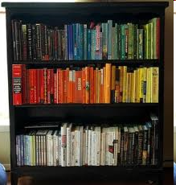
1,000,000 sentences = small shelf of books
Notes:
A shelf of books

Slide 26

10 million sentences = Large shelf of books

Slide 27

Large Data Trend Continues
We can’t process these by hand!!
Notes:
A library

Slide 28
What happens in reality?
We use Statistics & Machine Learning!

Slide 29
Statistical Machine Translation
Translator translates source into target text
Use machine learning techniques to extract useful knowledge
Translation model: word and phrase translations
Language model: how likely words follow in a particular sequence
Translation system (decoder) uses these models to find the best translation for new sentences
Advantages:
Can quickly train for new languages
Can adopt to new domains
Problems:
Need parallel data
Difficult to pin-point the causes of errors
Source
Target
Translation
Model
Language
Model
Source Sentence
Translation

Slide 30

Noisy Channel View
“French is actually English, which has been garbled during transmission; recover the correct, original English”
Noisy channel distorts into French
Speaker speaks
English
You hear French,
but need to recover
the English

Slide 31
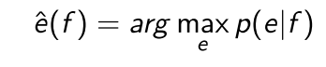
To get the best translation
Model the probability of a source language
sentence f of being translated into target
language sentence e
Notes:
Statistical Machine translation models the probability of a sentence F:
Of being the translation of a sentence E.
The decision rule maximizes that probability. Thus, We want to obtain the translation in English E that maximizes the probability of
F being translated into E.

Slide 32
Using a Bayesian Approach
Select translations which has highest probability
ê = argmax{ p(e | f) }
= argmax{ p(e) p(f | e) }
Model
Channel
Search
Process
Model
Source

Slide 33
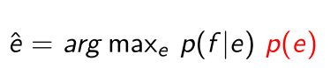
… that models translation
Language Model = fluency
Language Model
Translation Model
Decoder
Translation
Translation Model = fidelity
Decoder = search for optimal
Notes:
Using a the bayes rule, we can rewrite the first rule, into:
Which is known as the noisy channel model.
And it’s broken into three parts.
The language models, which gives fluency. I.e. how good “English” the translation is.
The translation model, which gives the fidelity. Or how good the translation E represents the original meaning of F
And the decoder, which is in charge of giving us the optimal translation.

Slide 34
Tasks in SMT
Modelling build statistical models which capture characteristic features of translation equivalences and of the target language
Training train translation model on bilingual corpus, train language model on monolingual corpus
Decoding find best translation for new sentences according to models
Evaluation
Subjective evaluation: fluency, adequacy
Automatic evaluation: WER, Bleu, etc
And all the nitty-gritty stuff
Text preprocessing, data cleaning
Parameter tuning (minimum error rate training)

Slide 35
Modelling for SMT
Preprocessing
Word Alignments
Phrase Extraction
Translation Model
How phrases are extracted (which ones, how many, etc).
How phrases are scored.
Certain features (lexical).

Slide 36
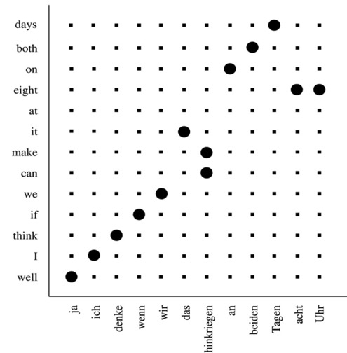
Word Alignment
Which word maps to
which word?
Observations:
Often 1-1
Some 1-to-many
Some 1-to-nothing
Often monotone, but some reordering
Not always clear-cut

Slide 37
Word Alignment
Calculate Viterbi path (i.e. path with highest probability)
e_{I}
e₁
f₁
f_{J}

Slide 38
Extract Phrases from Word Alignment
Read off source phrase – target phrase pairs
e_{I}
e₁
f₁
f_{J}

Slide 39
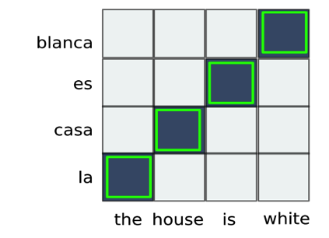
Phrase Extraction (up to length 4)
the | la
house | casa
is | es
white | blanca
the house | la casa
house is | casa es
is white | es blanca
the house is | la casa es
house is white | casa es blanca
the house is white | la casa es blanca

Slide 40
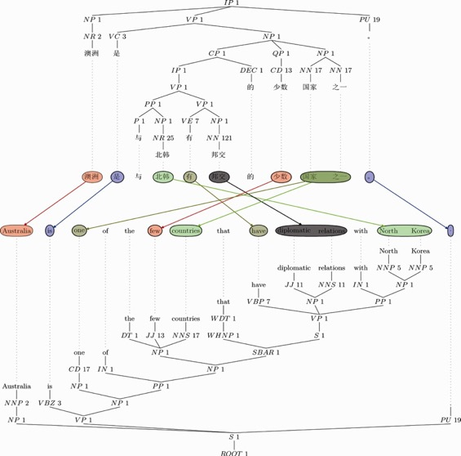
Syntax-based MT: Tree-to-Tree Alignment
Words don’t have to align one-to-one
Constituent labels can be different in each language
Tree Structures can be highly divergent
Notes:
40

Slide 41
Finding the best translation: Decoding
Decoder takes source sentence and all available knowledge (translation model, distortion model, language model etc) and generates a target sentence
Many alternative translations are possible
Too many to explore them all -> pruning is necessary
Pruning leads to search errors
Decoder outputs model-best translation
Ranking of hyps according to model is different from ranking according to external metric ☹
Bad translations get better models scores than good translations -> model errors

Slide 42
Decoding Issues
Languages have different word order
Modeled by distortion models
Exploring all possible reorderings computationally too expensive
Need to restrict reordering
Optimizing the system
We use a bunch of models (features), need to optimize scaling factors (feature weights)

Slide 43
Translation Lattice
All possible translations in a compact representation
Sentence: ich komme morgen zu dir
Reference: I will come to you tomorrow
I will come
to your office
I come
tomorrow
to
you
I
come
ich
komme
morgen
zu
dir
0
1
2
…
…
J

Slide 44
The Decoder: Two Level Approach
Build translation lattice
Run left-right over test sentence
Search for matching phrases between source sentence and phrase table (and other translation tables)
For each translation, insert edges into the lattice
Search for best path in lattice
Run left-right over lattice
Apply n-gram language model
Combine translation model scores and language model score
Trace back best hypothesis

Slide 45
Building Translation Lattice
Sentence: ich komme morgen zu dir
Reference: I will come to you tomorrow
Search in corpus for phrases and their translations
Insert edges into the lattice
I will come
to your office
I come
tomorrow
to
you
I
come
ich
komme
morgen
zu
dir
0
1
2
…
…
J

Slide 46
Searching for Best Translation
We have constructed a graph
Directed
No cycles
Each edge carries a partial translation (with scores)
Now we need to find the best path
Adding additional information (DM, LM, ….)
Allowing for some reordering

Slide 47
Monotone Search
Hypotheses describe partial translations
Coverage information, translation, scores
Expand hypothesis over outgoing edges
I will come
to your office
I come
tomorrow
to
you
I
come
ich
komme
morgen
zu
dir
h: c=0..4, t=I will come tomorrow zu
h: c=0..3, t=I will come tomorrow
h: c=0..4, t=I will come tomorrow to
h: c=0..5, t=I will come tomorrow to your office

Slide 48
With Word Reordering
Hypotheses describe a partial translation
Coverage information, translation, scores
Expand hypothesis over uncovered position (within window)
I will come
to your office
I come
tomorrow
to
you
I
come
ich
komme
morgen
zu
dir
h: c=11000, t=I will come
h: c=11011, t=I will come to your office
h: c=11111, t=I will come to your office tomorrow

Slide 49
Now you know how MT works
(roughly)

Slide 50
What are the Limitations?
Large-Data dependency
Some language pairs are not covered
Specific vocabulary might not be covered
Prone to errors
Model errors
Garbage in - garbage out
Alignment problems
Heuristic phrase extraction
Search errors
Dealing with incomplete information
Problem with long distance reordering
Efficiency tradeoffs

Slide 51
WHY should you care?
Part II: As a professional translator

Slide 52
Why is Machine Translation Important?
The translation industry is changing
Government organizations and big companies are adopting machine translation
Cases:
European Union: coping with translation volume and cost
Intel: automatic translation of knowledge base
eBay: machine translation to open markets

Slide 53
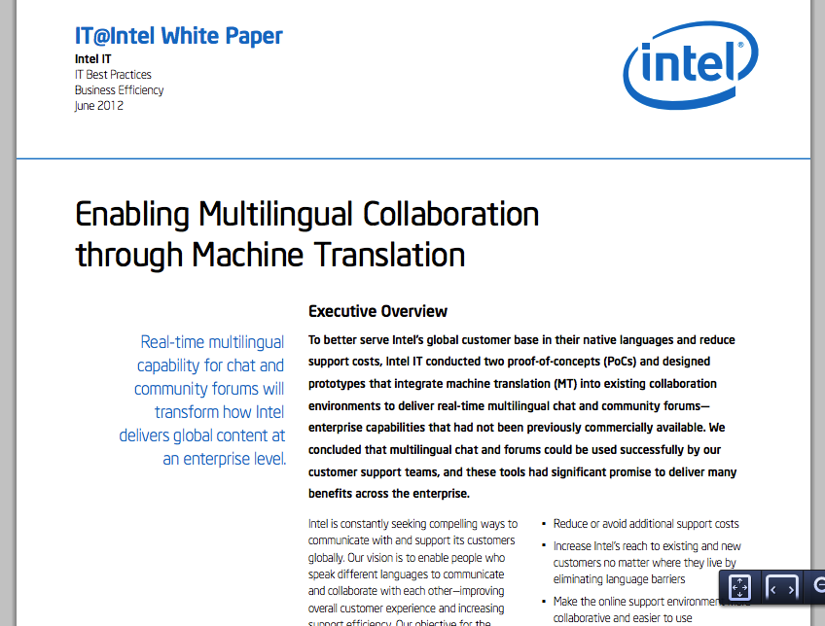
MT @ Intel
Serve customer
In their language
Reduce cost
Integrate machine translation
Into chat
And community forums
Significant promise
http://www.intel.com/content/dam/www/public/us/en/documents/white-papers/ enabling-multilingual-collaboration-through-machine-translation.pdf

Slide 54
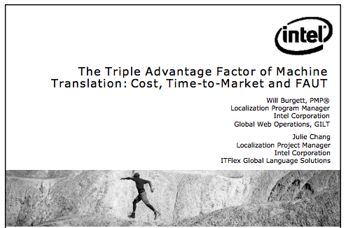
MT @ Intel
Fully Automatic Useful Translation
http://www.mt-archive.info/AMTA-2008-Burgett.pdf

Slide 55
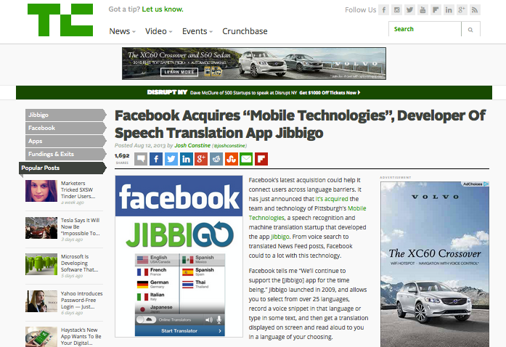
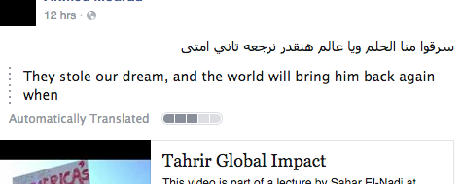
MT @ FB
Goal: Connect users across language barriers
Previously Bing translator was used
Now own team with translation and speech recognition experience

Slide 56
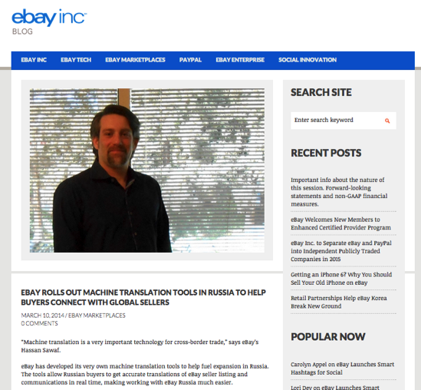
MT @ eBay
eBay has developed its very own machine translation tools to help fuel expansion in Russia. The tools allow Russian buyers to get accurate translations of eBay seller listing and communications in real time, making working with eBay Russia much easier.
eBay acquired MT technology from AppTek
http://blog.ebay.com/ebay-rolls-machine-translation-tools-russia-help-buyers-connect-global-sellers/

Slide 57
MT @ eBay
800M items are actively offered, 60M new daily
More than 150M active users
About every 3rd item changing hands on eBay goes across (language) borders
Serving 7 languages using eBay's MT for 22 countries
To translate one day's new item titles (w/o descriptions!) would require 200,000 translators
60M items new daily, 11 translation directions on average per item,
Human translators are put in the loop if sellers want to increase the quality of the translation by buying added human translation services.
From Hassan Sawaf (personal communication)

Slide 58

MT @ EU
The Problem
Translation Volume: In 2014 output was 2.30 million pages. Of this, 71% was done in-house and the rest by contractors.
Translation Cost:
€330m a year (estimated)
or some €0.60 for every EU citizen.
Solutions
Restrict length of document
Use automatic translation
http://ec.europa.eu/isa/documents/publications/ brochure-mt@ec-a5-v3_en.pdf

Slide 59
MT @ EU
MT @ EU
from and into all 24 EU official languages = 552 language pairs
trained on EU official documents
Objectives
Operation of a common Statistical Machine Translation service
Customize the service for specific administration needs
Benefits
Increasing speed to quickly understands the information
Reducing cost - human translation only for documents deemed important
Facilitating easier information exchange within and between interest groups
http://ec.europa.eu/isa/actions/02-interoperability-architecture/2-8action_en.htm

Slide 60
MT is enabling new workflows
(for you)

Slide 61
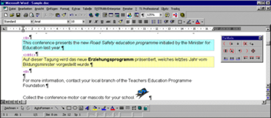
SMT vs Translation Memory
Translation Memory | Statistical Translation
Store your own translations for reuse | Build translation and language model from your (and other) translation to generate new translation
All or nothing: close match gives good result, if you don’t find exact or near match, nothing is returned | Always some result, quality degrades with coverage

Slide 62
Applications of SMT
Good for:
Not good for:
Reference
Translate short phrases, simple documents (EU)
Online content
Social media (Facebook)
Product listings (Ebay)
Communications
Speech translation (Skype)
Closed-vocabulary
Travel, weather
User manuals
Knowledge bases (Intel)
Critical content
Books
Legal documents
If publishing quality is needed, post-editing is done
Speed-up is reported
Post-editing makes sense when system output reaches good quality

Slide 63
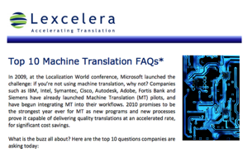
MT does not replace HT!
Top 10 Machine Translation FAQs
By Lori Thicke, Lexcelera and Translators without Borders
Q3: Will Machine Translation replace human translators?
Yes and No. Certain types of content, such as online knowledge bases, require only “understandable” quality to be successful. In these cases properly customized MT can be published as is, without human intervention. However, for the majority of cases where optimal quality is required, MT functions as a productivity tool for human translators; in this case, post-editing the raw MT output is dramatically faster than translating from scratch.
http://www.lexcelera.com/wp-content/uploads/2011/05/Top-10-MT-FAQs.pdf

Slide 64


Post-Editing
MT is a friend not a foe
Input text
Machine Translation
Editable text
Post-edited text
I see a brown bear.
أرى الدب البني
أرى دباً بنياً

Slide 65
A Win-Win Situation
Better MT
Faster Post Editing
More content translated
More data
Post-editing can increase translation turnaround (40%, Sousa et al, 2011)
As translations become more accessible, more content can be translated
Better MT systems and assistive tools can be built with new data

Slide 66
Change of Paradigm
Translators
System developers
Translators and Post-Editors are different
Different sets of skills
Training is needed
Researchers are (often) not Translators
Research Post-Editing systems are hard to use
Need to focus on usability
More interactive, user friendly tools

Slide 67
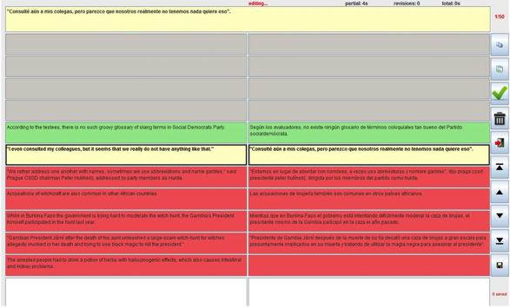
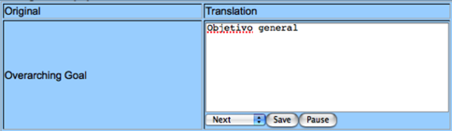
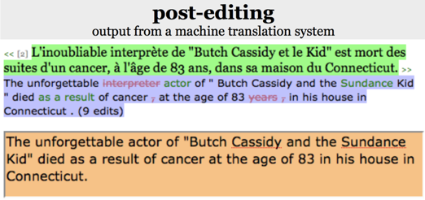
Post-Editing Tools in the Past
Existing Post-editing tools
Online tool, Univ. of Wolverhampton
Caitra, Univ. of Edinburg
PET (Aziz et al, 2012)
Input text
Machine Translation
Editable text
Post-edited text
I see a brown bear.
أرى الدب البني
أرى دباً بنياً

Slide 68

Most Recent Attempts
EU-funded projects for Computer-Assisted Translation
Focus on interactivity
http://www.casmacat.eu/
https://www.matecat.com/

Slide 69
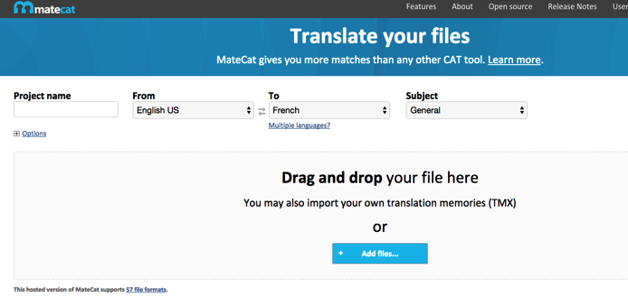
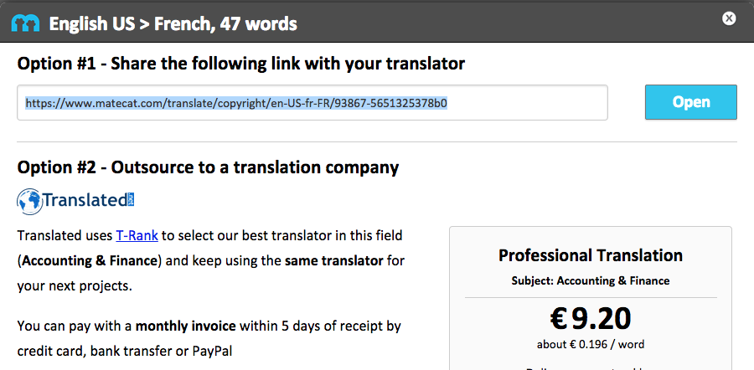
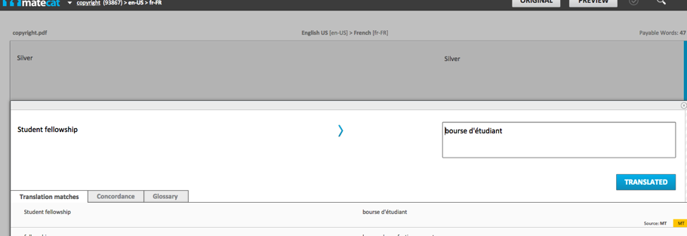
MATECAT Example

Slide 70
MT @ QCRI
Part III: What’s next?

Slide 71
QCRI’s Mission for Arabic Language Technology
Promoting the Arabic language in the information age by conducting world-class research in all aspects of Arabic language technologies

Slide 72
Arabic Language Technology
Arabic NLP Stack
Tools and Resources
Build strong foundation: Arabic NLP
2 flagship projects
3 supplementary focus areas motivated by local needs
Multi-lingual
Language Processing: Transcription and
Translation
Interactive
Question Answering
Doha 22
Search and
Information
Extraction
Arabic
Optical
Character
Recognition
Educational
Applications

Slide 73
Multi-lingual Language Processing @ALT
Develop new techniques
Answer interesting questions about language
Basic Research
Applied Research
Improve people’s lives with technology
Discover new problems

Slide 74

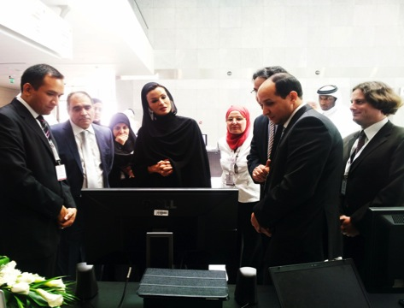

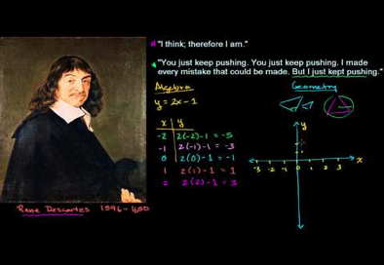

Speech Translation
Lectures
News
Meetings

Slide 75
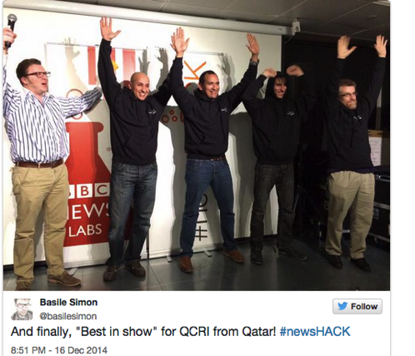
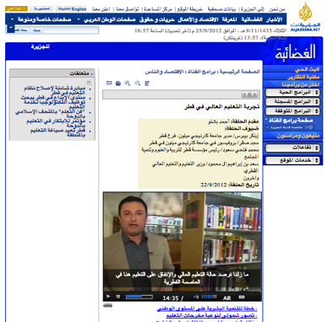
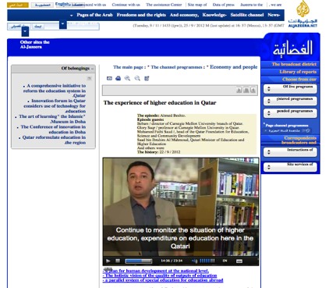
Application: News Translation
Objective: high quality speech recognition and translation
Enable video search
Collaboration with Aljazeera
http://alt.qcri.org/QCRI_Demo/Speech_Recognition.html

Slide 76

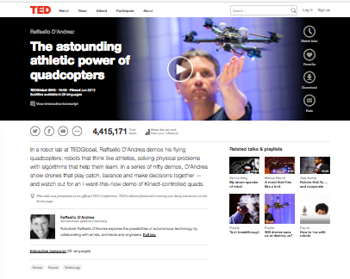
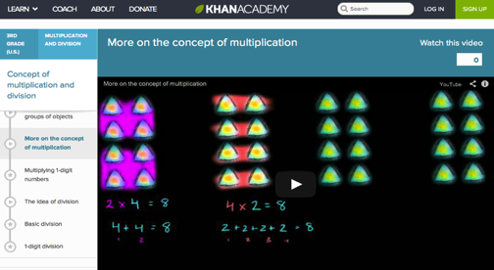
Application: Lecture Translation
Objective: enable wider reach of educational material
Primarily English -> Arabic

Slide 77






Data collection to enable research
Recording lectures at local conferences
Unique data: speech + simultaneous interpretation
In cooperation with:
Collecting lectures and talks from Web
Speech, subtitles, translations, voice-over
In cooperation with:
100
11k
20
Hours speech
Transcribed AR-EN
English subtitles
Languages

Slide 78
Understanding Interpretation
The WAW (و) corpus
100
Hours speech
Transcribed AR-EN
100
Hours speech
Translated (coming soon)
Original Speech
Transcribed Speech
Challenges:
Alignment
Translation of Speech
Transcribed Interpretation
Original Interpretation

Slide 79
Possible uses
Use statistics to determine which words are most often dropped
Useful for real-time Speech Translation systems
Analyze differences in lexical choices between translators and interpreters
[ Insert your ideas here]
We want to collaborate with you!
Wikipedia.org

Slide 80
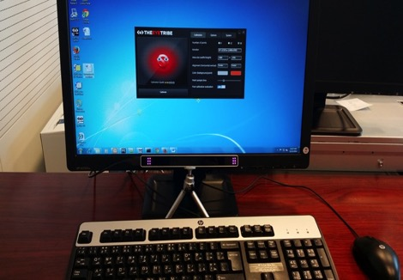

Understanding Consumption of Translations
Using commercial-level technology
These were some of you at our eye-tracking demo
EEG
FER
EYET

Slide 81
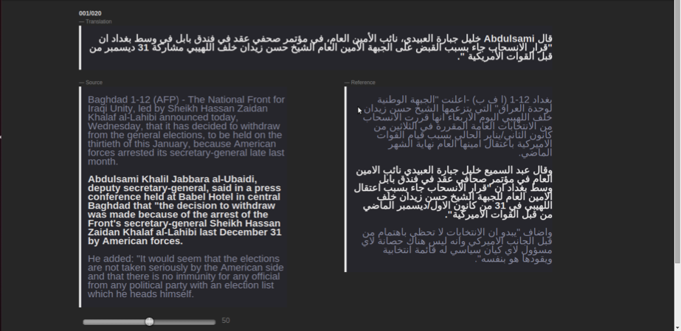
Case1: How do we Evaluate Translations?
Translated sentence to evaluate (in Arabic)
Reference translation for comparison (in Arabic).
Note: The sentence to evaluate is in bold.
Original text (in English).
Note: The translated sentence is in bold.
Move the slider to evaluate. “0” means “Very bad”/ “100” means “Very Good”.

Slide 82
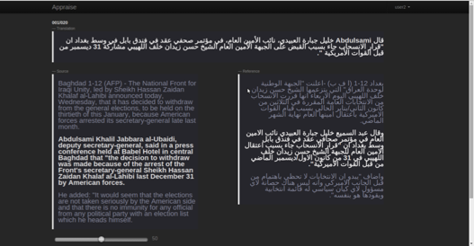
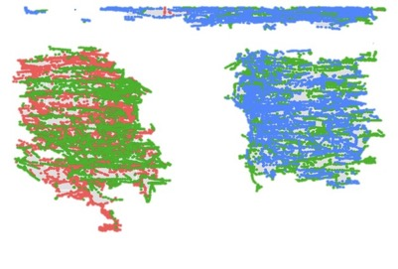
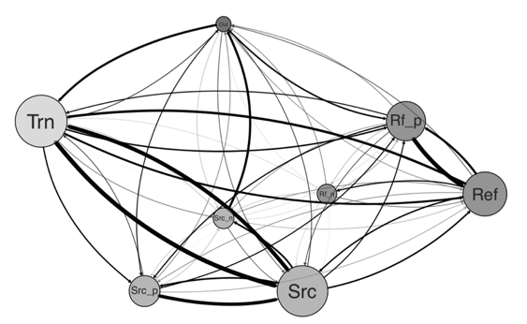
Preliminary Results: Analytics
Where do people look?
The flow of the process

Slide 83
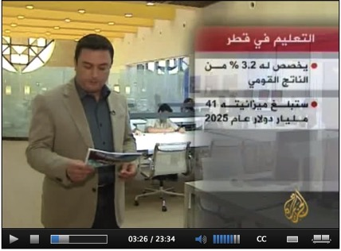
Possible Uses
Study the eye movements for reading foreign language subtitles
Which words are enough to convey meaning?
Which [wrong] words cause confusion?
Can benefit Speech Translation
Study the reading strategies of Arabic L2 learners
to adapt the TII Language Center programs
[ Insert your ideas here]
We want to collaborate with you!
the total will be spent on education by the year 2025 will go beyond 41 billion dollars,

Slide 84


Application: Meeting Translation
Objective: real-time, low-latency translation
Flexible architecture based on cutting-edge technology

Slide 85
Bridging Language Barriers in Health Care
WCMC-Q identified language gap in hospitals
Offer training program for medical interpretation
Can technology help?
Our answer: Yes!
What do you think?

Slide 86
Conclusion
Statistical Machine Translation learns how to produce optimal translations from large amounts of translations
The industry is changing the way they use MT to produce translations
Translators and MT systems can work together and benefit from each other
At QCRI we are focusing on Multilingual Language Processing, and have plenty of opportunities for collaboration

Slide 87

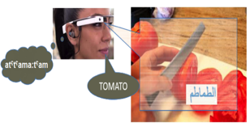
QCRI Hot summer – Cool Research Summer Internship Program
Runs for 8 weeks from May 10, 2015 to July 2, 2015.
Application start date: March 29, 2015
Application end date: April 5, 2015
Two summer internships for translators/interpreters:
Medical translation for doctor-patient communication in Qatar
Teach me Arabic!
For more information:
http://www.qcri.com/join-us/intern-with-us/summer-internships
Contact Dr. Irina Temnikova at itemnikova@qf.org.qa

Slide 88
Questions?
Thank you for listening!

Slide 89

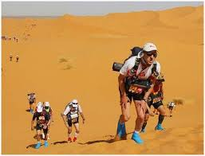

Running for Charity
Charity ‘Hope for Children’
Works in countries like Ghana, Kenya, Tanzania
Improve the welfare of children, provide education, fight trafficking
The run: Marathon des Sables
In desert of Morocco, 5th-11th April
6 stages, total of 260km, longest stage 90km
Runners need to carry food, sleeping bag, etc
Final long training run
Friday, QF Clubhouse to Zekreet (65km)
https://2015mds.everydayhero.com/uk/stephan-vogel

Slide 91
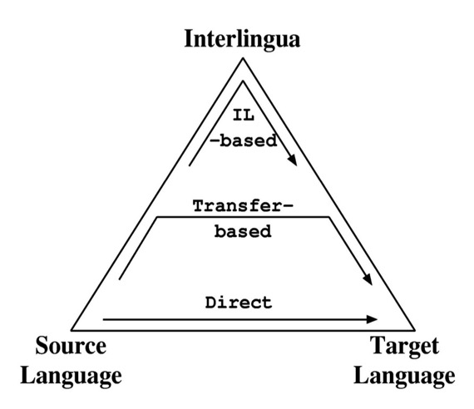
Machine Translation Approaches
Grammar-based
Interlingua-based
Transfer-based
Direct
Example-based
Statistical

Slide 92
Statistical MT
Machine Translation
Statistical
Rule-based
Example-based
Started in 80’s (IBM Candide).
Statistical Analysis of bilingual texts.
Not bound to source/target language.
Has proven to be very eﬀective.
As long as we have enough training data.
Notes:
Now, many of the translators online use Statistical Machine Translation.
It’s one of the several types of MT paradigms
But became very popular in the late 80’s, early 90’s.
Because it does not require complex linguistic rules,
Rather is based on statistical analysis f bilingual texts.
Thus, it’s not bounded to a specific source language target. And it’s very effective (as long as we have enough training data)

Slide 93
Statistical versus Grammar-Based
Often statistical and grammar-based MT are seen as alternatives, even opposing approaches – wrong !!!
Dichotomies are:
Use probabilities || everything is equally likely, yes/no decision
Rich (deep) structure || no or only flat structure
Both dimensions are continuous
Goal: structurally rich probabilistic models
 | No Probs | Probs
Flat Structure | EBMT | SMT
Deep Structure | XFER, Interlingua | Holy Grail

Slide 94
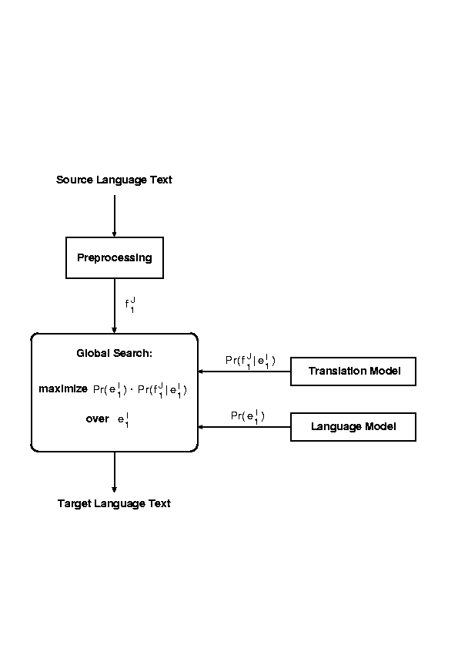
SMT Architecture
p(e) – language model
p(f | e) – translation model

Slide 95
Automatic Generation of Word Alignment
e_{I}
e₁
f₁
f_{J}

Slide 96
Learn Phrase Translations
e_{I}
Alignment conflict
e₁
f₁
f_{J}

Slide 97
Dealing with Asymmetry
Word alignment models are asymmetric; Viterbi path has:
multiple source words – one target word alignments
but no one source word – multiple target words alignments
Train alignment model also in reverse direction, i.e. target -> source
Using both Viterbi paths:
Simple: extract phrases from both directions and merge tables
‘Merge’ Viterbi paths and extract phrase pairs according to resulting pattern

Slide 98
Combine Viterbi Path
e_{I}
F->E
E->F
Intersect.
e₁
f₁
f_{J}

Slide 99
Finding the best translation: Decoder
Decoding issues
Two step decoding
Generation of translation lattice
Best path search
With limited word reordering

